Slide 1
SPACE INVADERS GAME
Submitted by:
Name:-Pratham Kumar Gupta
Roll no.2003490100022

Slide 2
OBJECTIVE:-
The aim is to destroy the rows of aliens as they move horizontally across the screen ,moving faster and faster as you pass levels. Once you destroy one wave of aliens, get ready to face another faster and more difficult wave of aliens If you allow any space invaders to reach the bottom of the screen or enemies bullets consume your lives , the alien invasion has been successful and the games ends.
To control a spaceship and shoot down the enemy aliens to score points.
To avoid colliding with the enemy aliens and their bullets.
To progress through each level by destroying all enemy aliens.
To use power-ups and bonuses to gain an advantage over the enemy aliens.
To achieve a high score by achieving the objectives of each level

Slide 3
INTRODUCTION:-
Space Invaders is a stationary shooter in which the player fires at aliens overhead by moving a laser weapon horizontally across the bottom of the screen. As a group, the aliens travel left and right, shifting downward as they approach the screen’s edge. The objective is to shoot all of the aliens to death. The game finishes quickly if the invaders reach the bottom of the screen while the player has three lives.

Slide 4
SOFTWARE AND HARDWARE REQUIREMENTS:
SOFTWARE REQUIREMENT :
Python
Pygame
OS-Windows
Pycharm
HARDWARE REQUIREMENT:
with 8gb ram
512gb SSD
Intel core i5 10th Generation
Intel UHD Graphics

Slide 5
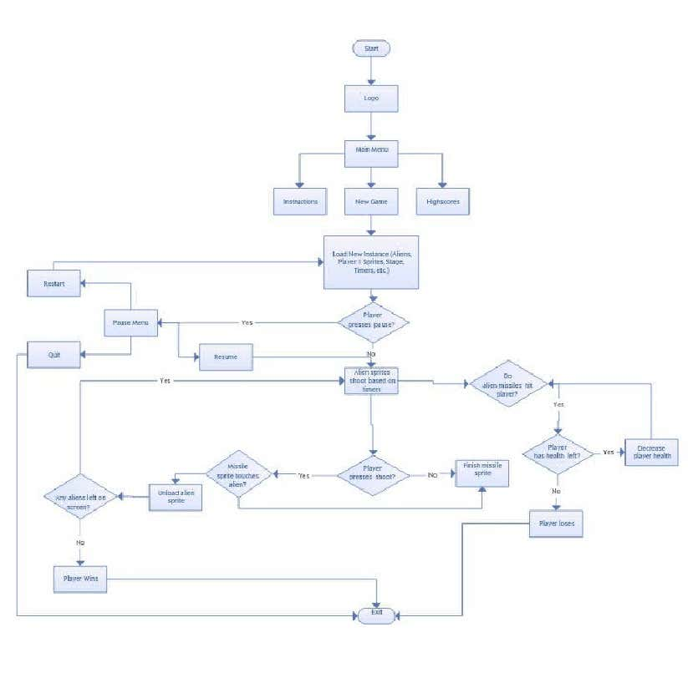
FLOWCHART:-

Slide 6
TECHNOLOGY USED:
PYTHON:-
Python is a high-level, general-purpose programming language. Its design philosophy emphasizes code readability with the use of significant indentation. Python is dynamically-typed and garbage-collected. It supports multiple programming paradigms, including structured (particularly procedural), object-oriented and functional programming. It is often described as a "batteries included" language due to its comprehensive standard library .

Slide 7
PYCHARM:-
PyCharm is a dedicated Python Integrated Development Environment (IDE) providing a wide range of essential tools for Python developers, tightly integrated to create a convenient environment for productive Python, web, and data science development. PyCharm is a cross-platform IDE that works on Windows, macOS, and Linux.
PyCharm is the most popular IDE used for Python scripting language.
This chapter will give you an introduction to PyCharm and explains its features.
PyCharm offers some of the best features to its users and developers in the following aspects:
Code completion and inspection

Slide 8
Approach:
Import the required module.
Initialize the pygame.
Create three functions:
o isCollision(): Which tells us whether the collision has occurred or not?
o game_over(): Which returns True or False on the basis of which the code decided if the game has ended.
o show_score(x, y): This shows the score on the screen
Create an infinite loop to execute the code continuously.

Slide 9
RESULT INTERFACE:

Slide 10
CONCLUSION:-
This Online Space invaders game provides facility to paly space invaders game anywhere and anytime . It save time since user does not need to wait for result So all user get extra knowledge and skills . This project has helped us in getting a dearer understanding of real word application development . This is the part that I have mostenjoyed , because I really like programming and designing game logic.

Slide 11
FUTURE SCOPE:-
In the future, space invader games could be further enhanced with more levels, more enemies, and more challenging levels. There could be online leaderboards and tournaments, allowing players to compete against each other. Additionally, the game could offer special power-ups or rewards for completing certain levels or achieving certain milestones. There could also be new weapons, such as lasers or missiles, to add a new layer of strategy.

Slide 12
REFERENCES AND BIBLIOGRAPHY:-
BOOKS USED:
Python programming version 3.7.4(Dr.A.Kannan,Dr.L.Sai Ramesh)
Software Engineering (Shalini Puri)
Software Engineering (Pressman)
SITES USED :
www.scribd.com
www.wikipedia.org
https://www.geeksforgeeks.org/building-space-invaders-using-pygame-python/
htps://github.com/

Slide 13
THANK YOU

